Slide 1
“If I run alone, I can run faster; but if we run together we can run farther”
African Proverb
Sally Farrier - 27 October 2017

Slide 2
Sally Farrier - 27 October 2017

Slide 3
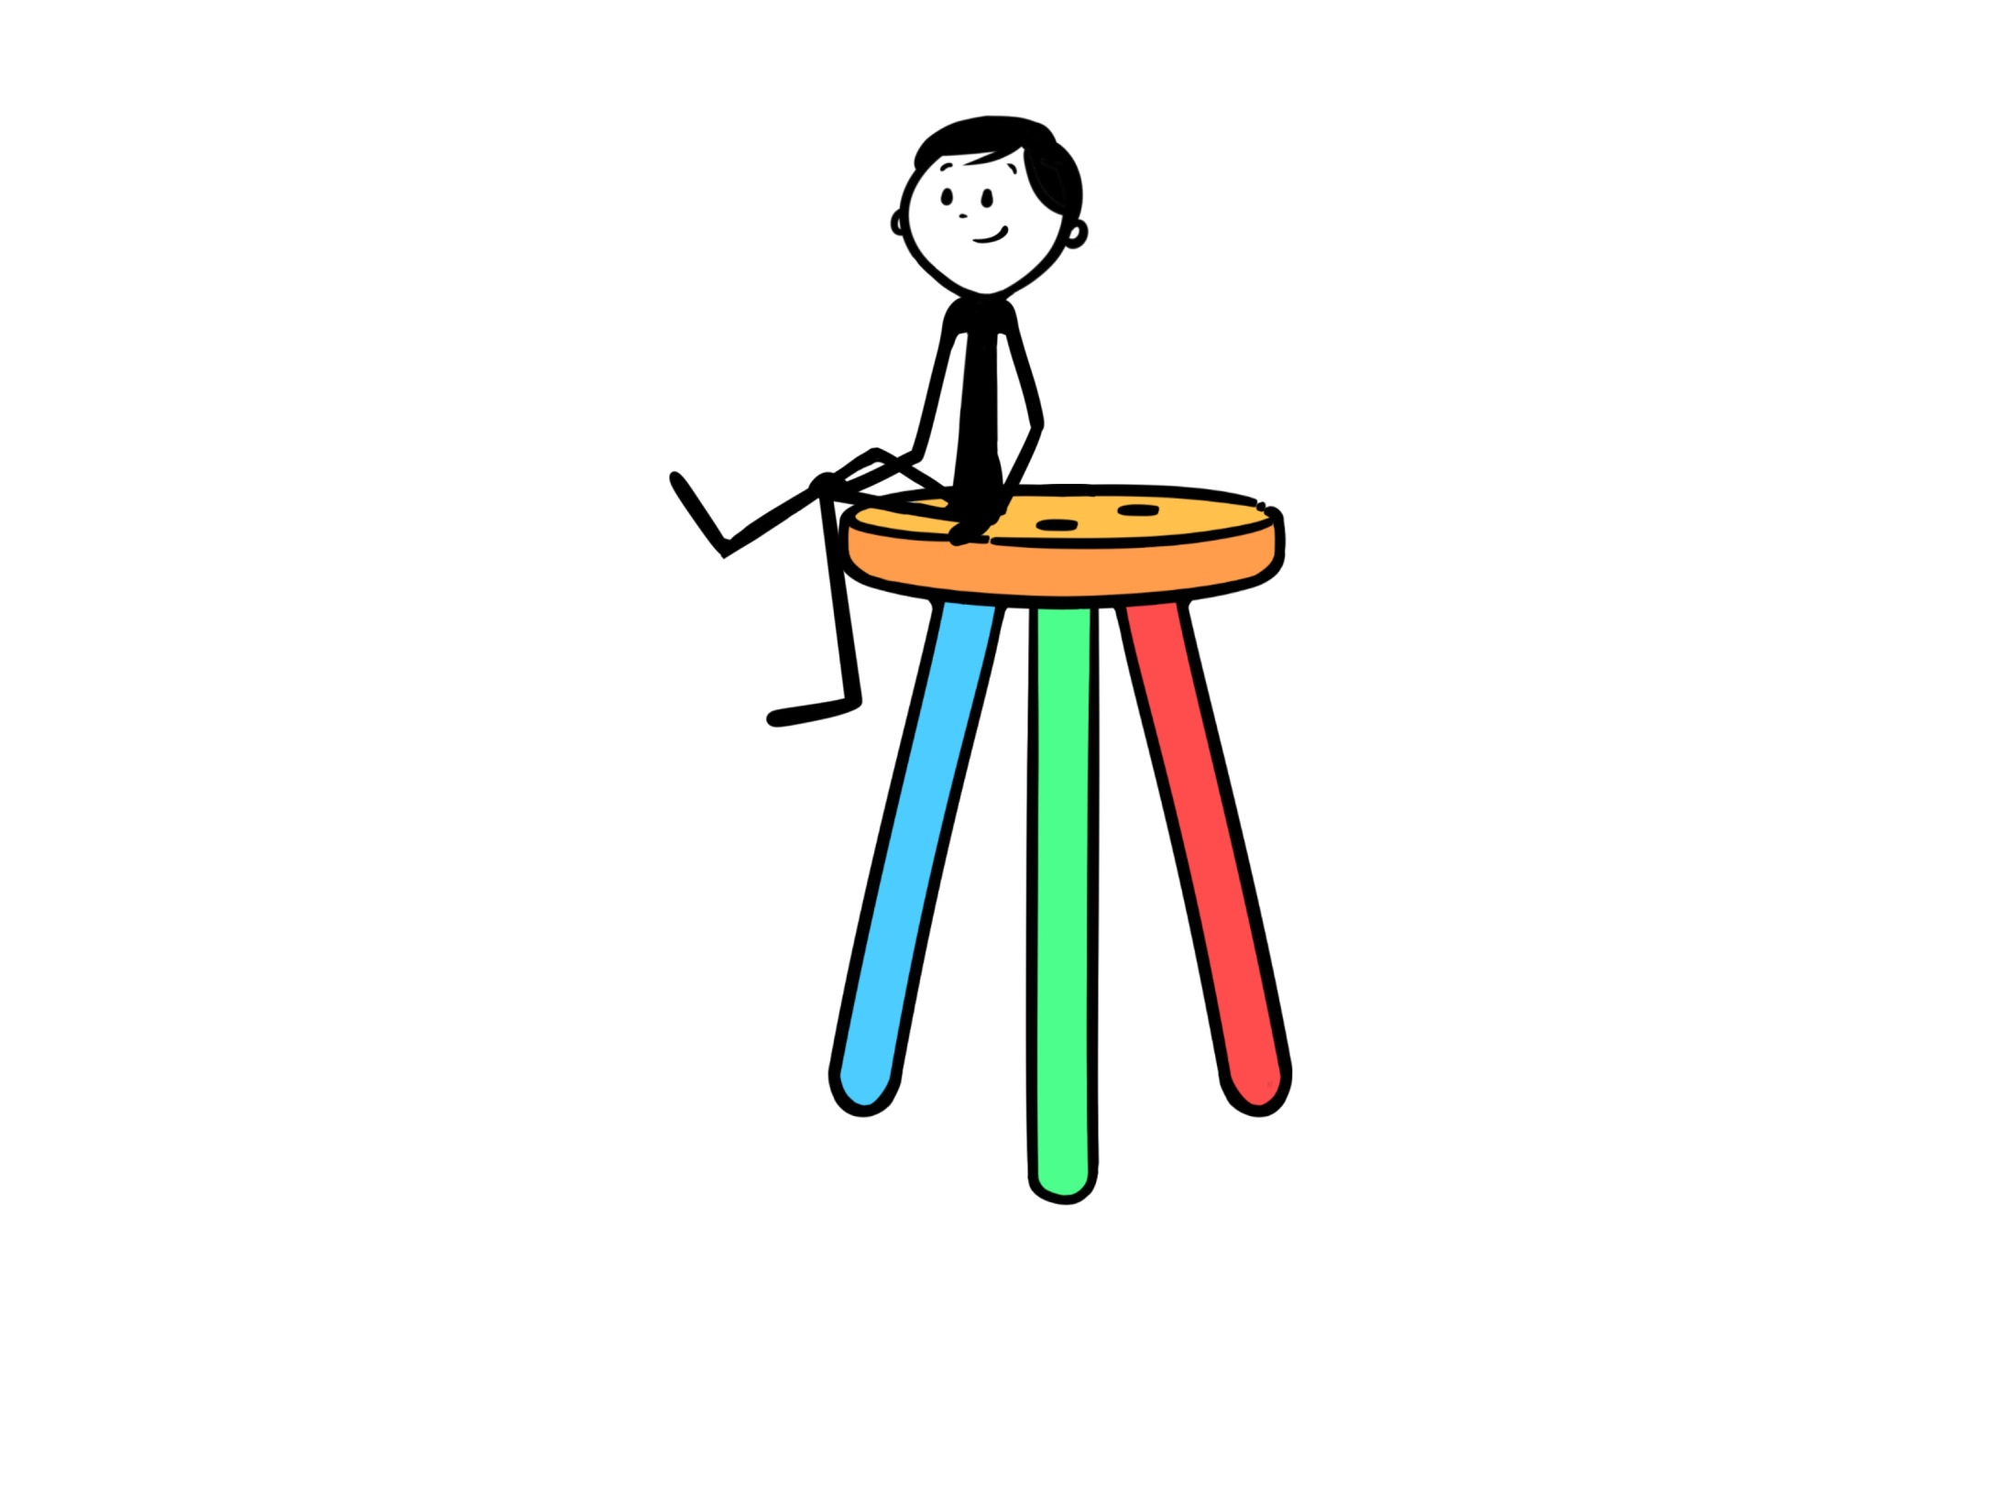
Sally Farrier - 27 October 2017

Slide 4
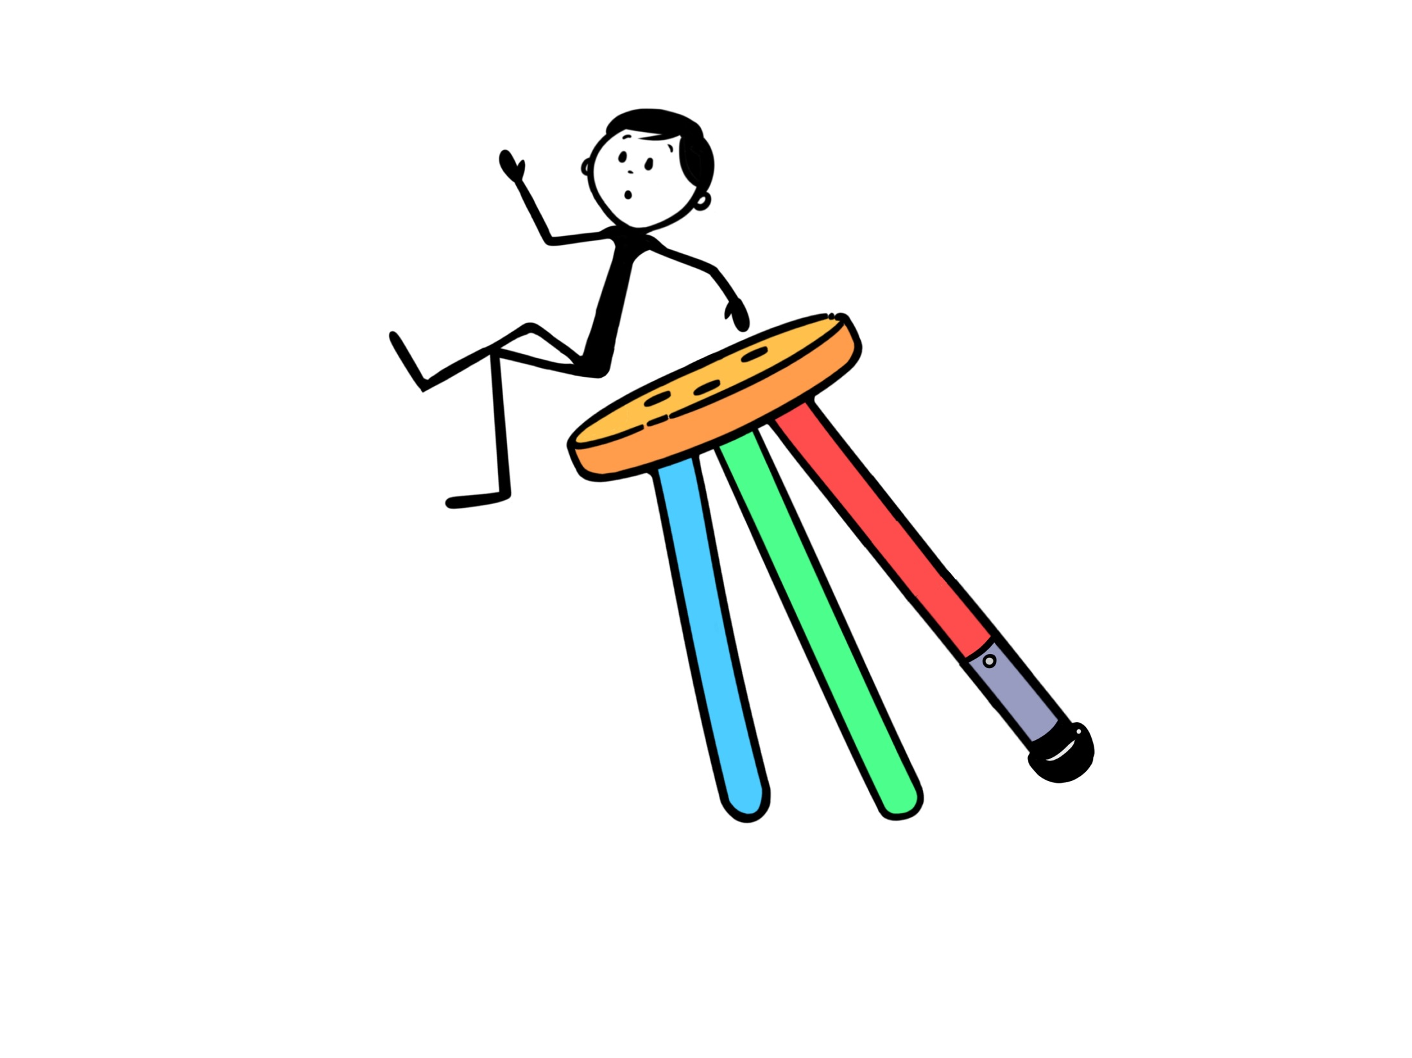
Sally Farrier - 27 October 2017

Slide 5
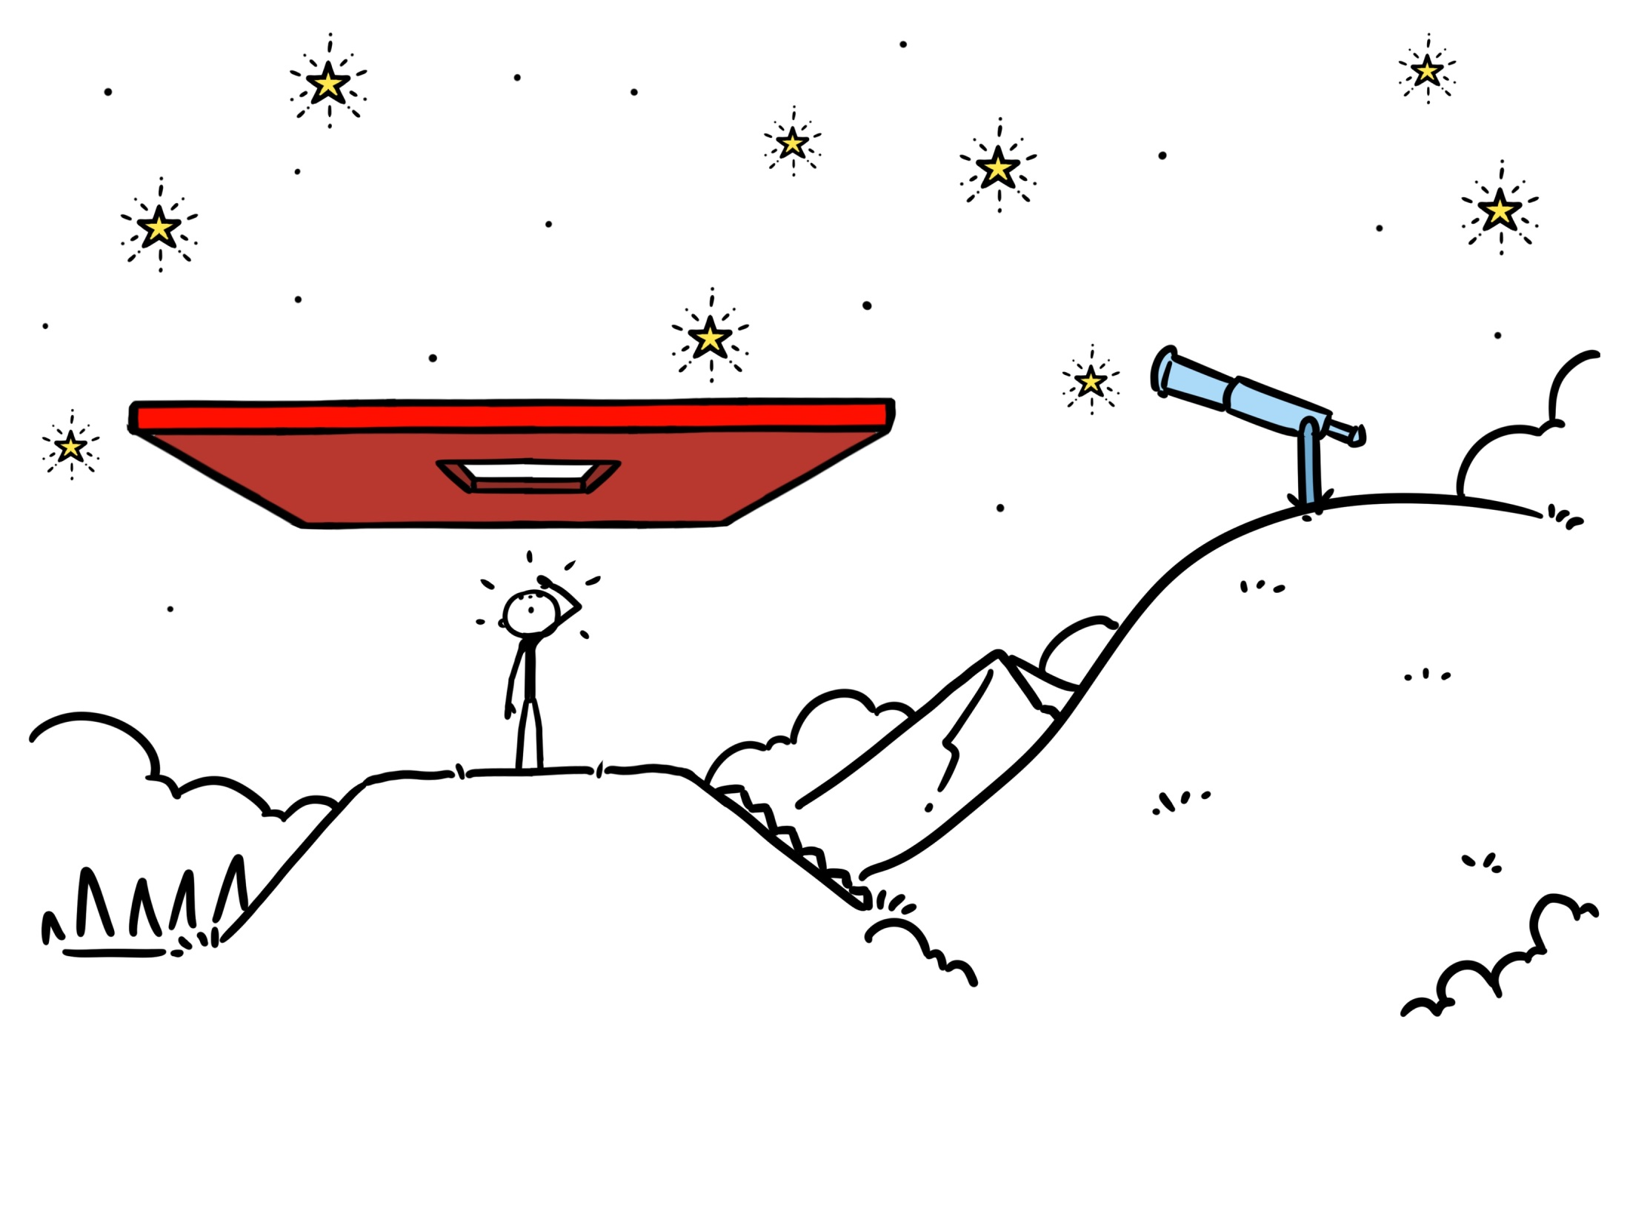
Sally Farrier - 27 October 2017

Slide 6
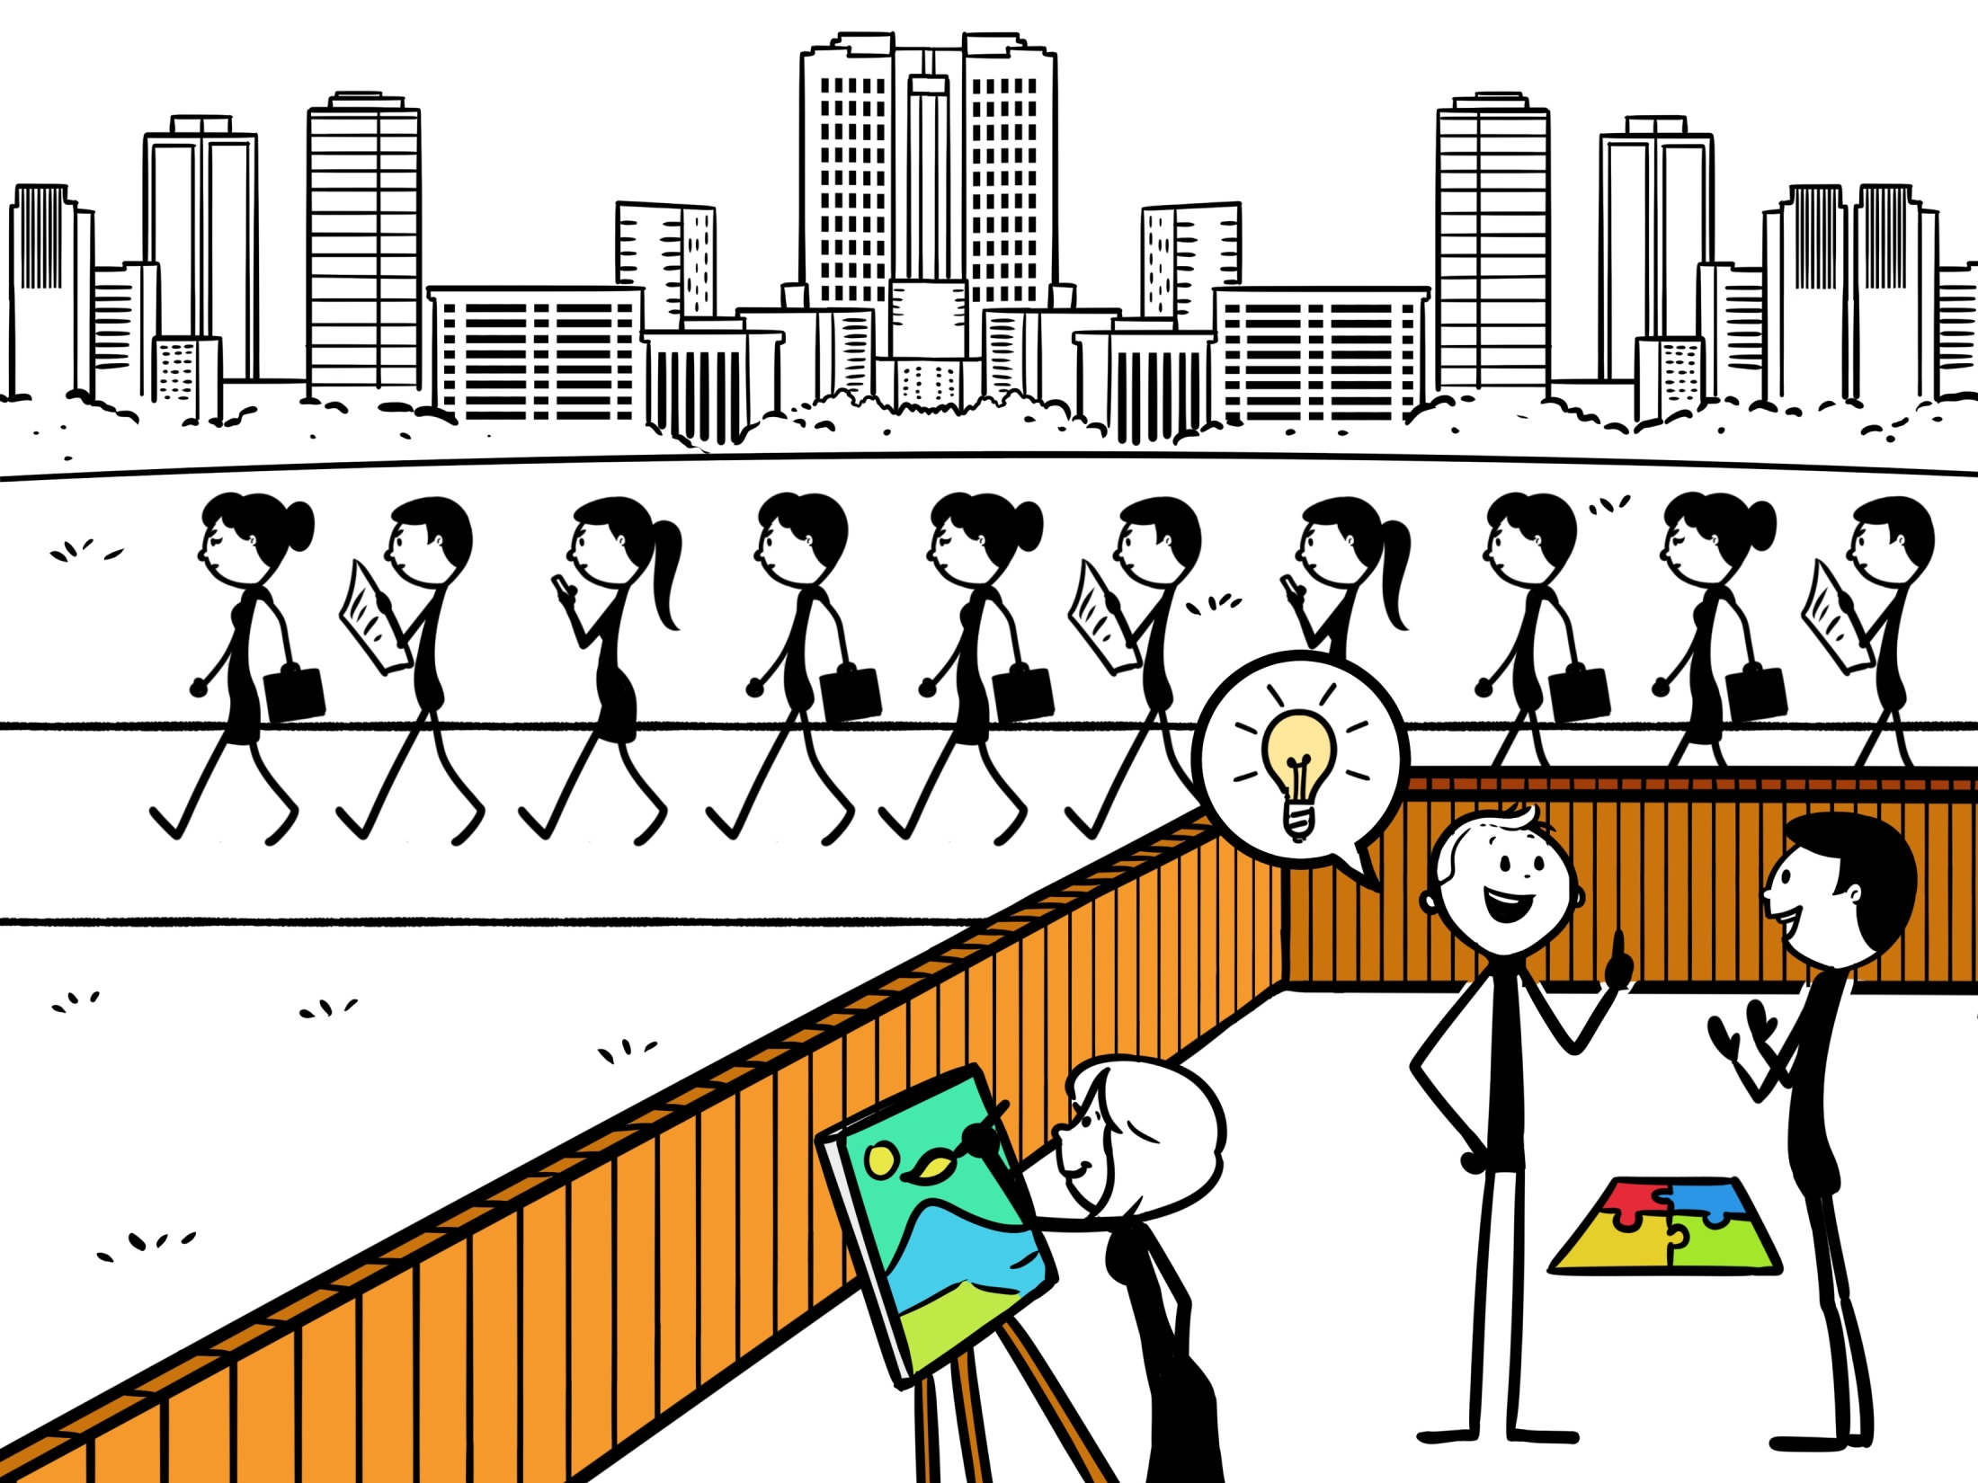
Sally Farrier - 27 October 2017

Slide 7
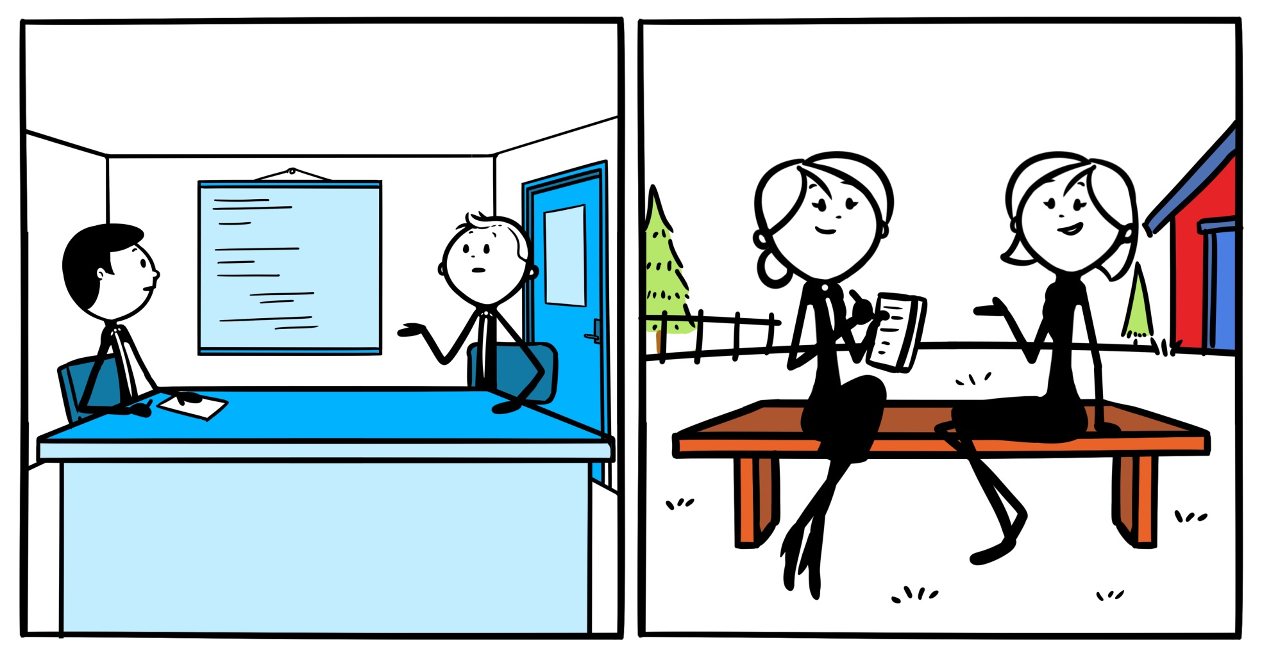
Sally Farrier - 27 October 2017

Slide 8
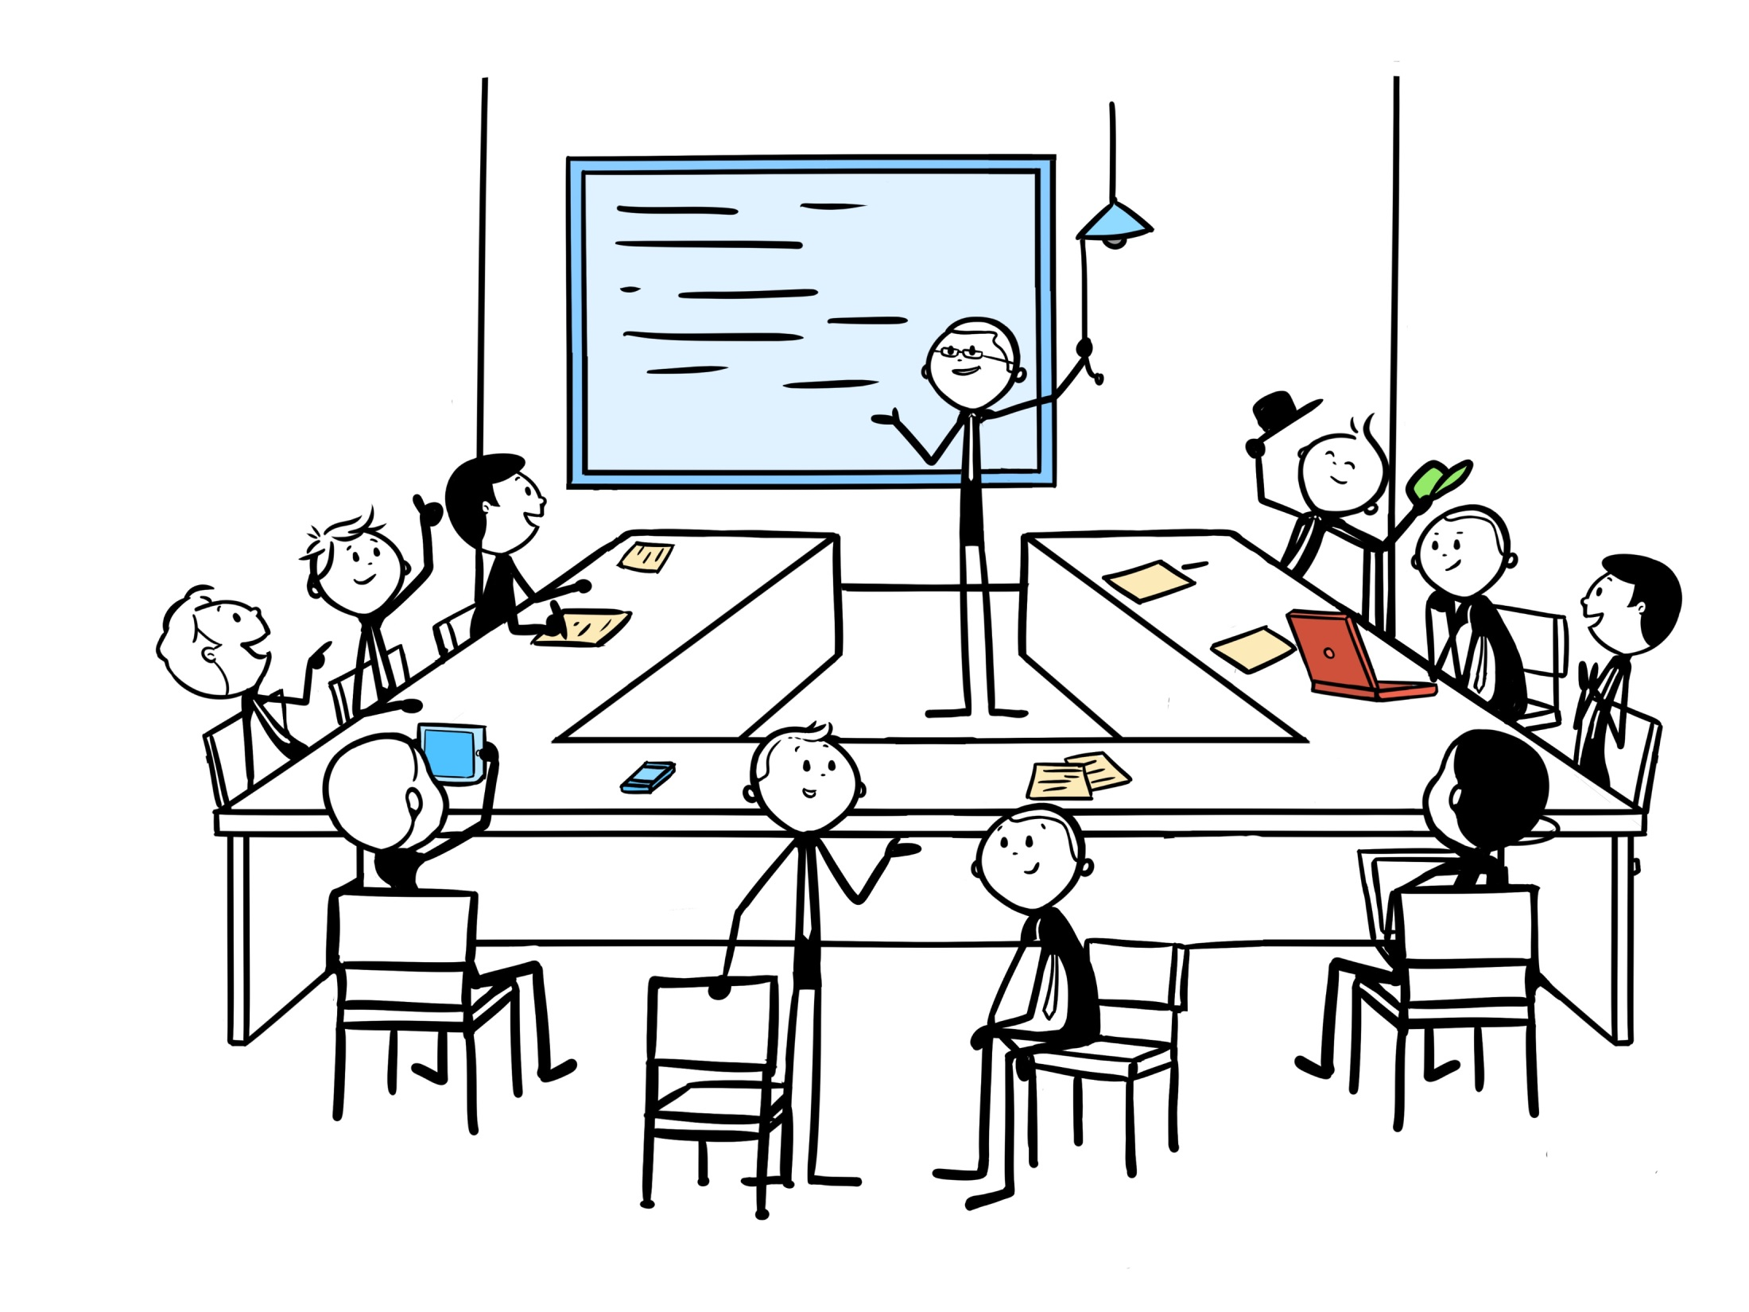
Sally Farrier - 27 October 2017

Slide 9
“If I had an hour to solve a problem, I’d spend 55 minutes thinking about the problem and 5 minutes thinking about solutions.”
Albert Einstein
Sally Farrier - 27 October 2017

